Slide 1

Project Title: UK Train Rides Dashboard
Presenter's Name: Moaz Adel Abdelsalam
Date: 16/5/2025

Slide 2
Project Idea
Problem
Train passengers in the UK frequently face delays, cancellations, and inconsistent service quality.
These issues negatively impact passenger satisfaction and operational efficiency.
Without clear data insights, identifying root causes and performance patterns is challenging.
Solution
Developed an interactive Power BI dashboard analyzing 31,653 real-world train booking records.
Provides insights into ticket sales, peak travel times, delay patterns, refund trends, and passenger behavior.
Empowers decision-makers to improve service delivery and operational efficiency.
Unique Value
Transforms complex railway data into an intuitive, decision-focused dashboard.
Designed for both technical and non-technical users.
Addresses business pain points, reduces losses, and enhances customer satisfaction through evidence-based decisions.

Slide 3
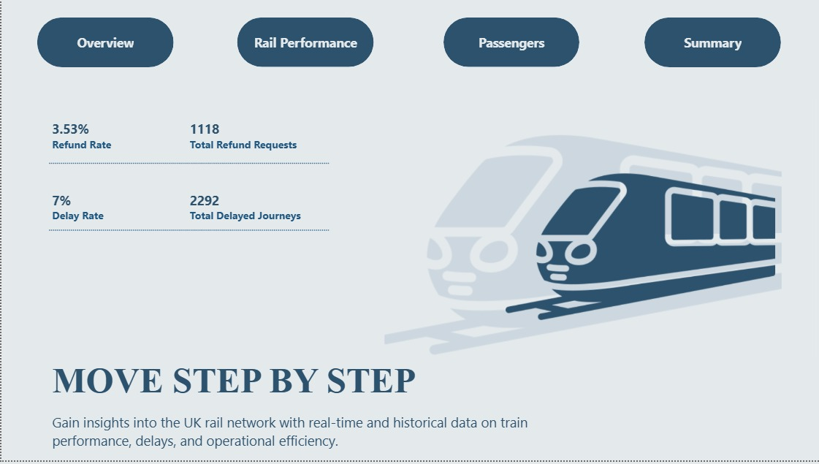
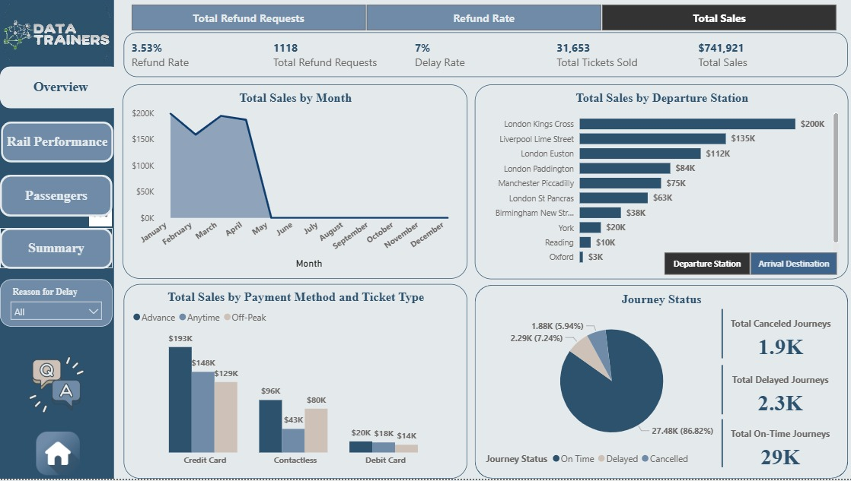
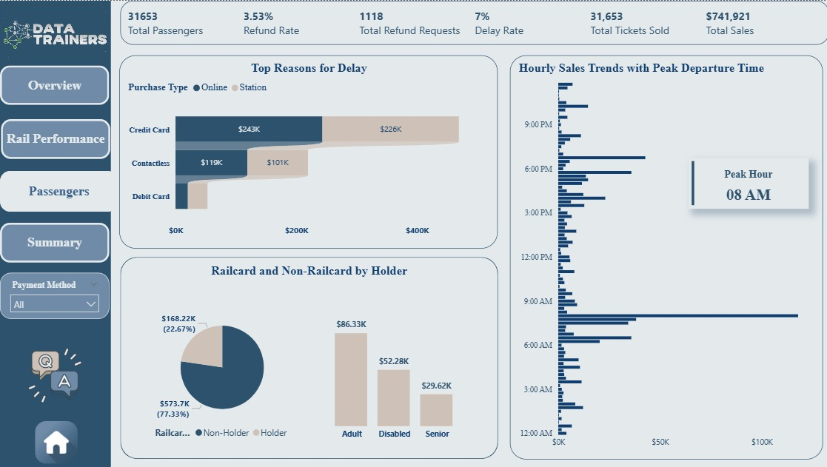
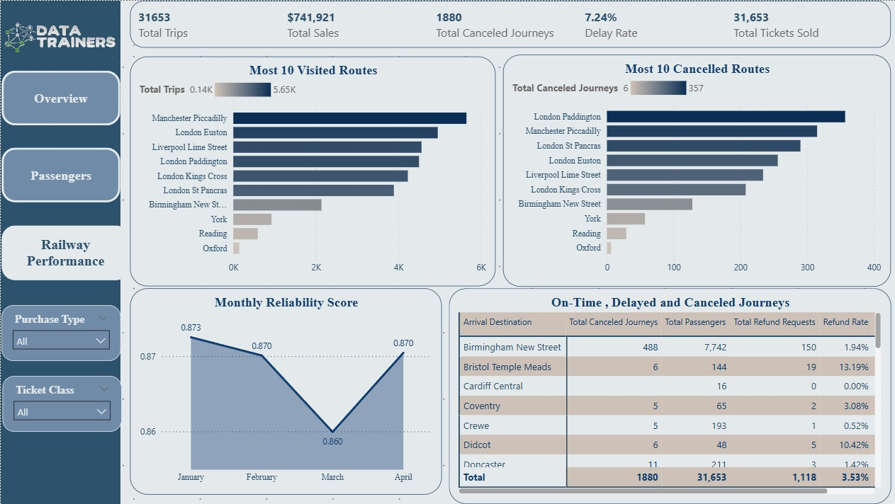
Dashboard
Home
2. Overview
3. Passenger
4. Rail Performance

Slide 4
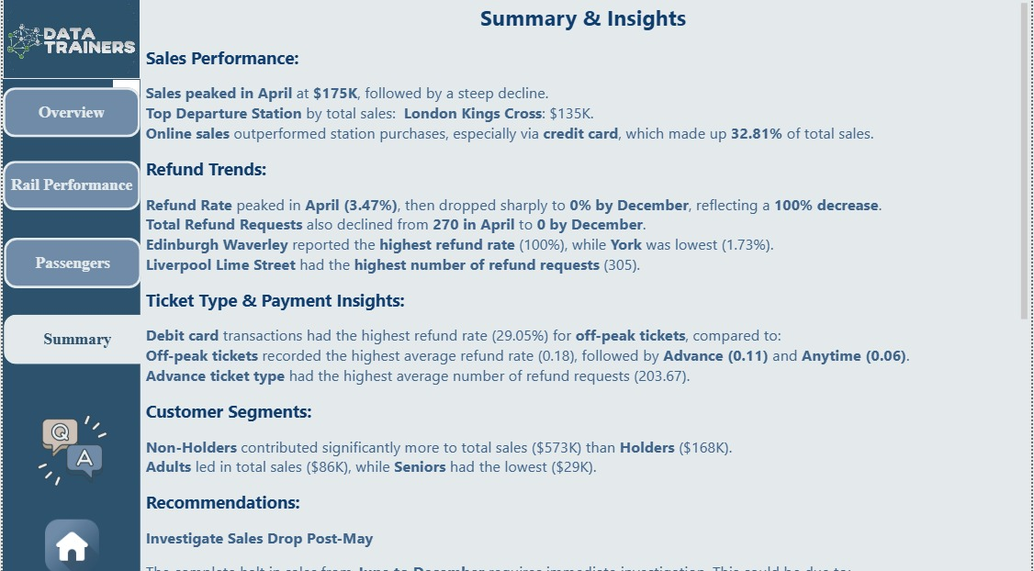
Insights
Sales Performance:
Sales peaked in April at $175K, followed by a steep decline.
Top Departure Station by total sales: London Kings Cross: $135K.
Online sales outperformed station purchases, especially via credit card, which made up 32.81% of total sales.
Refund Trends:
Refund Rate peaked in April (3.47%), then dropped sharply to 0% by December, reflecting a 100% decrease.
Total Refund Requests also declined from 270 in April to 0 by December.
Edinburgh Waverley reported the highest refund rate (100%), while York was lowest (1.73%).
Liverpool Lime Street had the highest number of refund requests (305).
Ticket Type & Payment Insights:
Debit card transactions had the highest refund rate (29.05%) for off-peak tickets, compared to:
Off-peak tickets recorded the highest average refund rate (0.18), followed by Advance (0.11) and Anytime (0.06).
Advance ticket type had the highest average number of refund requests (203.67).
Customer Segments:
Non-Holders contributed significantly more to total sales ($573K) than Holders ($168K).
Adults led in total sales ($86K), while Seniors had the lowest ($29K).

Slide 5
Project Wireframe
User Interface Design:
Homepage: Summary KPIs on revenue, ticket sales, delays.
Dashboard Pages: Delay analytics, refund requests, customer trends, route-level performance.
User Journey:
Login (optional for hosted report).
Select timeframe or filters (date, station, ticket type).
Interact with visualized data through maps, graphs, and tables.
Export or print summaries for stakeholder use.

Slide 6
End Users + Features
User Personas
Operations Managers: Monitor train performance and delays to optimize schedules.
Customer Service Teams: Track refunds and satisfaction trends to enhance customer experience.
Sales & Marketing Analysts: Analyze purchasing behavior to optimize marketing efforts.
Executives: Gain a high-level overview of efficiency, revenue, and operational metrics.
Key Features
Ticket Sales Breakdown: By type, channel, and payment method.
Peak Travel Time & Route Analysis.
Delay & Punctuality Monitoring: Per station and time slot.
Refund Insights: Correlations with ticket type and payment.
Customer Behavior Tracking: Top ticket types, buying times.
Interactive Filtering & Drill-Downs: For customized exploration.
How Features Solve Needs
Enables managers to reduce delays.
Helps service teams address refund spikes.
Allows analysts to improve promotional strategies.
Provides executives with clear KPIs for strategic decisions.

Slide 7
Data Structure & Flow
Architecture
Flat-file CSV (non-relational), processed in Power BI.
Contains 31,653 ticket booking records.
Data Flow
Source: Raw CSV file.
Cleaned in Excel & Power Query.
Loaded into Power BI.
Transformed using DAX & Filters.
Displayed via interactive dashboard.
Techniques
Data cleaning, timestamp parsing.
Time-of-day categorization.
Delay grouping, refund analytics.
KPI calculation with DAX.
Key Entities
Ticket: Type, Class, Price, Refund.
Customer: Purchase Channel, Payment Method.
Journey: From/To Stations, Date, Time.
Performance: On-Time, Delay Reason, Duration.
Refund: Reason, Approval Status.

Slide 8
Programming Languages + Frameworks
Languages
DAX: For custom measures and KPIs.
M Language: For data transformation in Power Query.
Excel Formulas: For initial data cleaning.
Frameworks/Tools
Power BI Desktop: For modeling and visualization.
Power Query Editor: For ETL operations.
Excel: For data preparation and validation.

Slide 9
Live Application + Test
Current State
Status: Currently in Beta stage, running on Power BI Desktop.
Deployment: Ready for publishing on Power BI Service for wider access.
Development: Refining data model and visuals based on initial feedback.
Testing Phases
Data Validation: Manual checks to ensure accuracy of imported and transformed data.
Measure Testing: Verified DAX calculations using sample data scenarios.
Filter & Slicer Testing: Ensured proper behavior and interactivity across visuals.
User Testing: Team members reviewed usability, layout, and business clarity.
User Feedback
Strengths:
Clear breakdown of delays, refunds, and sales.
Easy navigation for both technical and non-technical users.
Suggestions for Improvement:
Add more detailed visuals for refund patterns and delay causes.
Next Steps: Publish to Power BI Service and gather feedback from real users.

Slide 10
Deliverables
Reports & Documentation
Power BI Dashboard: Interactive analysis of train ticket and travel data.
Project Presentation (PowerPoint): Full overview with visuals and insights.
Business Report (PDF/Word): Summarized analysis, KPIs, and recommendations.
Data Cleaning Documentation: Preprocessing steps with before/after examples.
Timeline
Week 1: Data understanding & cleaning.
Week 2: Data modeling & KPI identification.
Week 3: Dashboard creation (visuals, slicers, insights).
Week 4: Final documentation, testing, and presentation preparation.
Final Product
Fully working Power BI .pbix file.
Presentation file (.pptx).
Optional: Cleaned dataset with readme.

Slide 11
Project Team + Roles
Team Members
Moaz Adel Abdelsalam - Data Modeling & DAX: Creating data relationships, writing DAX measures, optimizing structure.
Roaa Mohamed Saad - Dashboard Development & Visualization: Designing visual layout, building charts, ensuring clarity.
Aya Osama Ramadan - Visualization & DAX: Supporting visuals, creating measures, aligning with business needs.
Marwan Walid AbdElmetaal - Business Analysis & Insights: Identifying business questions, deriving insights, presenting findings.
Hana Islam Saber Elmallah - Data Cleaning & Preprocessing (ETL): Handling missing data, formatting, transforming raw data.
Collaboration
Weekly meetings via Microsoft Teams.

Slide 12
Thank You
Thank You
We appreciate your time and attention.
Feel free to reach out for questions or feedback.
Contact
Email: moaazadel2002@gmail.com
Phone: 01151708523
Feedback
Your input helps us deliver more impactful dashboards!

